Slide 1
Lecture 9: Testing and Quality assurance
based on Chapter 10

Slide 2
Details of Testing (What to test?)
Testing

Slide 3
Testing
Testing only reveals the presence of defects
Does not identify nature and location of defects
Identifying & removing the defect => role of debugging and rework
Preparing test cases, performing testing, defects identification & removal all consume effort
Overall testing becomes very expensive : 30-50% development cost
Testing

Slide 4
Incremental Testing
Goals of testing: detect as many defects as possible, and keep the cost low
Both frequently conflict - increasing testing can catch more defects, but cost also goes up
Incremental testing - add untested parts incrementally to tested portion
For achieving goals, incremental testing essential
  helps catch more defects
  helps in identification and removal
Testing of large systems is always incremental
Testing

Slide 5
Integration and Testing
Incremental testing requires incremental ‘building’ I.e. incrementally integrate parts to form system
Integration & testing are related
During coding, different modules are coded separately
Integration - the order in which they should be tested and combined
Integration is driven mostly by testing needs
Testing

Slide 6
Top-down and Bottom-up
System : Hierarchy of modules
Modules coded separately
Integration can start from bottom or top
Bottom-up requires test drivers
Top-down requires stubs
Both may be used, e.g. for user interfaces top-down; for services bottom-up
Drivers and stubs are code pieces written only for testing
Testing

Slide 7
Levels of Testing
The code contains requirement defects, design defects, and coding defects
Nature of defects is different for different injection stages
One type of testing will be unable to detect the different types of defects
Different levels of testing are used to uncover these defects
Testing

Slide 8
Levels of Testing…
User needs
Acceptance testing
Requirement
specification
System testing
Design
Integration testing
code
Unit testing
Testing

Slide 9
Unit Testing
Different modules tested separately
Focus: defects injected during coding
Essentially a code verification technique, covered in previous chapter
Unit Testing is closely associated with coding
Frequently the programmer does Unit Testing; coding phase sometimes called “coding and unit testing”
Testing

Slide 10
Integration Testing
Focuses on interaction of modules in a subsystem
Unit tested modules combined to form subsystems
Test cases to “exercise” the interaction of modules in different ways
May be skipped if the system is not too large
Testing

Slide 11
System Testing
Entire software system is tested
Focus: does the software implement the requirements?
Validation exercise for the system with respect to the requirements
Generally the final testing stage before the software is delivered
May be done by independent people
Defects removed by developers
Most time consuming test phase
Testing

Slide 12
Acceptance Testing
Focus: Does the software satisfy user needs?
Generally done by end users/customer in customer environment, with real data
The software is deployed only after successful Acceptance Testing
Any defects found are removed by developers
Acceptance test plan is based on the acceptance test criteria in the SRS
Testing

Slide 13
Other forms of testing
Performance testing
  Tools needed to “measure” performance
Stress testing
  load the system to peak, load generation tools needed
Regression testing
  Test that previous functionality works alright
  Important when changes are made
  Previous test records are needed for comparisons
  Prioritization of test cases needed when complete test suite cannot be executed for a change
Testing

Slide 14
Test Plan
Testing usually starts with test plan and ends with acceptance testing
Test plan is a general document that defines the scope and approach for testing for the whole project
Inputs are SRS, project plan, design
Test plan identifies what levels of testing will be done, what units will be tested, etc in the project
Testing

Slide 15
Test Plan…
Test plan usually contains
  Test unit specifications: what units need to be tested separately
  Features to be tested: these may include functionality, performance, usability,…
  Approach: criteria to be used, when to stop, how to evaluate, etc
  Test deliverables
  Schedule and task allocation
  Example Test Plan
    IEEE Test Plan Template
Testing

Slide 16
Test case specifications
Test plan focuses on approach; does not deal with details of testing a unit
Test case specification has to be done separately for each unit
Based on the plan (approach, features,..) test cases are determined for a unit
Expected outcome also needs to be specified for each test case
Testing

Slide 17
Test case specifications…
Together the set of test cases should detect most of the defects
Would like the set of test cases to detect any defect, if it exists
Would also like set of test cases to be small - each test case consumes effort
Determining a reasonable set of test cases is the most challenging task of testing
Testing

Slide 18
Test case specifications…
The effectiveness and cost of testing depends on the set of test cases
Q: How to determine if a set of test cases is good? I.e. the set will detect most of the defects, and a smaller set cannot catch these defects
No easy way to determine goodness; usually the set of test cases is reviewed by experts
This requires test cases be specified before testing – a key reason for having test case specifications
Test case specifications are essentially a table
Testing

Slide 19
Test case specifications…
Seq.No
Condition
to be tested
Expected
result
successful
Test Data
Testing

Slide 20
Test case specifications…
So for each testing, test case specifications are developed, reviewed, and executed
Preparing test case specifications is challenging and time consuming
  Test case criteria can be used
  Special cases and scenarios may be used
Once specified, the execution and checking of outputs may be automated through scripts
  Desired if repeated testing is needed
  Regularly done in large projects
Testing

Slide 21
Test case execution and analysis
Executing test cases may require drivers or stubs to be written; some tests can be automatic, others manual
  A separate test procedure document may be prepared
Test summary report is often an output – gives a summary of test cases executed, effort, defects found, etc
Monitoring of testing effort is important to ensure that sufficient time is spent
Computer time also is an indicator of how testing is proceeding
Testing

Slide 22
Defect logging and tracking
A large software system may have thousands of defects, found by many different people
Often person who fix the defect (usually the coder) is different from the person who finds the defect
Due to large scope, reporting and fixing of defects cannot be done informally
Defects found are usually logged in a defect tracking system and then tracked to closure
Defect logging and tracking is one of the best practices in industry
Testing

Slide 23
Defect logging…
A defect in a software project has a life cycle of its own, like
  Found by someone, sometime and logged along with information about it (submitted)
  Job of fixing is assigned; person debugs and then fixes (fixed)
  The manager or the submitter verifies that the defect is indeed fixed (closed)
More elaborate life cycles possible
Testing

Slide 24
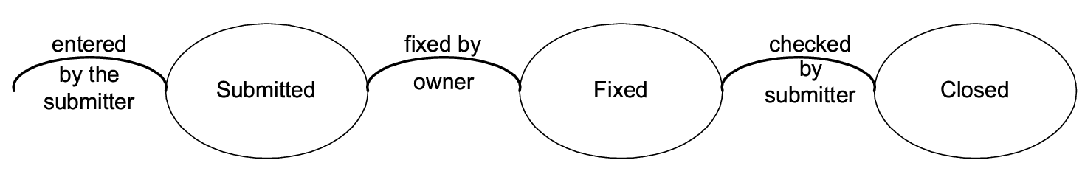
Defect logging…
Testing

Slide 25
Defect logging…
During the life cycle, information about defect is logged at different stages to help debug as well as analysis
Defects generally categorized into a few types, and type of defects is recorded
  Orthogonal Defect Classification (ODC) is one classification with categories
    Functional, interface, assignment, timing, documentation, algorithm
  Some standard industry categories
    Logic, standards, user interface, component interface, performance, documentation
Testing

Slide 26
Defect logging…
Severity of defects in terms of its impact on software is also recorded
Severity useful for prioritization of fixing
One categorization
  Critical: Show stopper
  Major: Has a large impact
  Minor: An isolated defect
  Cosmetic: No impact on functionality
See sample peer review form
  Peer Review Form
Testing

Slide 27
Defect logging and tracking…
Ideally, all defects should be closed
Sometimes, organizations release software with known defects (hopefully of lower severity only)
Organizations have standards for when a product may be released
Defect log may be used to track the trend of how defect arrival and fixing is happening
Testing

Slide 28
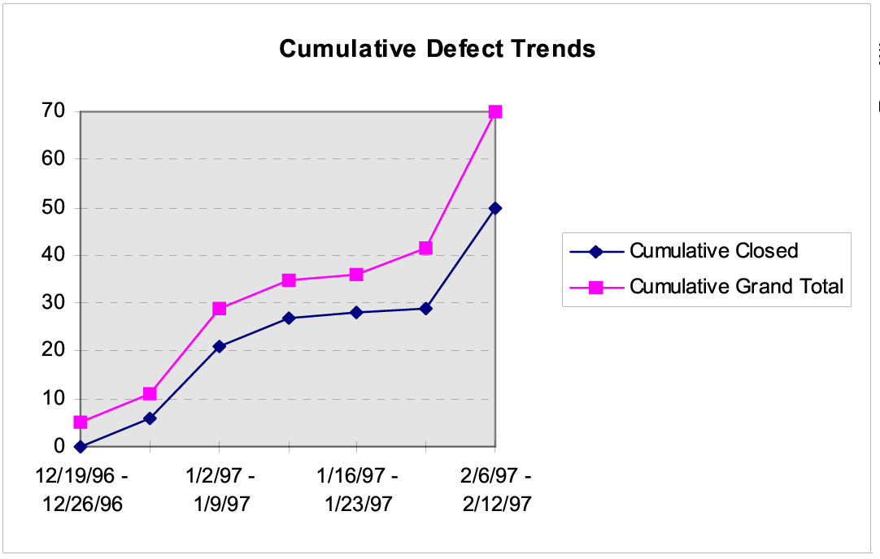
Defect arrival and closure trend
Testing

Slide 29
Defect analysis for prevention
Quality control focuses on removing defects
Goal of defect prevention is to reduce the defect injection rate in future
Defect Prevention done by analyzing defect log, identifying causes and then remove them
Is an advanced practice, done only in mature organizations
Finally results in actions to be undertaken by individuals to reduce defects in future
Testing

Slide 30
Metrics - Defect removal efficiency
Basic objective of testing is to identify defects present in the programs
Testing is good only if it succeeds in this goal
Defect removal efficiency of a Quality Control activity = % of present defects detected by that Quality Control activity
High Defect Removal Efficiency of a quality control activity means most defects present at the time will be removed
Testing
Notes:
22

Slide 31
Defect removal efficiency …
Defect Removal Efficiency for a project can be evaluated only when all defects are know, including delivered defects
Delivered defects are approximated as the number of defects found in some duration after delivery
The injection stage of a defect is the stage in which it was introduced in the software, and detection stage is when it was detected
  These stages are typically logged for defects
With injection and detection stages of all defects, Defect Removal Efficiency for a Quality Control activity can be computed
Testing
Notes:
25

Slide 32
Defect Removal Efficiency …
Defect Removal Efficiencies of different Quality Control activities are a process property - determined from past data
Past Defect Removal Efficiency can be used as expected value for this project
Process followed by the project must be improved for better Defect Removal Efficiency
Testing
Notes:
26

Slide 33
Metrics – Reliability Estimation
High reliability is an important goal being achieved by testing
Reliability is usually quantified as a probability or a failure rate
For a system it can be measured by counting failures over a period of time
Measurement often not possible for software as due to fixes reliability changes, and with one-off, not possible to measure
Testing

Slide 34
Reliability Estimation…
Software reliability estimation models are used to model the failure followed by fix model of software
Data about failures and their times during the last stages of testing is used by these model
These models then use this data and some statistical techniques to predict the reliability of the software
A simple reliability model is given in the book
Testing

